Slide 1
Uncertainty in measuring schemes

Slide 2
Method
Two datasets from Dalby et al. 2023 were selected as reference datasets. The control and weekly flushing sections were chosen. Emissions were including enteric emission.
The emissions rates in the datasets were scaled to emission factors from commercial pig farms. A list of the emission factors are also presented in Dalby et al. 2023.
During each campaign simulation, 4 emission factors were randomly sampled, thereby creating four datasets with random absolute emission (but the same emission pattern as the Dalby datasets).

Slide 3
Two measuring schemes
In Scheme 1.
1 measuring period = 7 days
2 measuring periods per batch, with 1 measuring period in each half of the batch. The measuring periods were randomly assigned in each half. This gives 8 measuring periods pr. batch pr. year.
In Scheme 2.
1 measuring period = 7 days
Four predefined week sets were made and the sets were during each simulation assigned randomly to the four batches. In total 12 measuring periods pr. batch pr. year.
set1: 1, 5, 9,
set2: 4, 8, 12,
set3: 3, 7, 11
set 4: 2, 6, 10

Slide 4
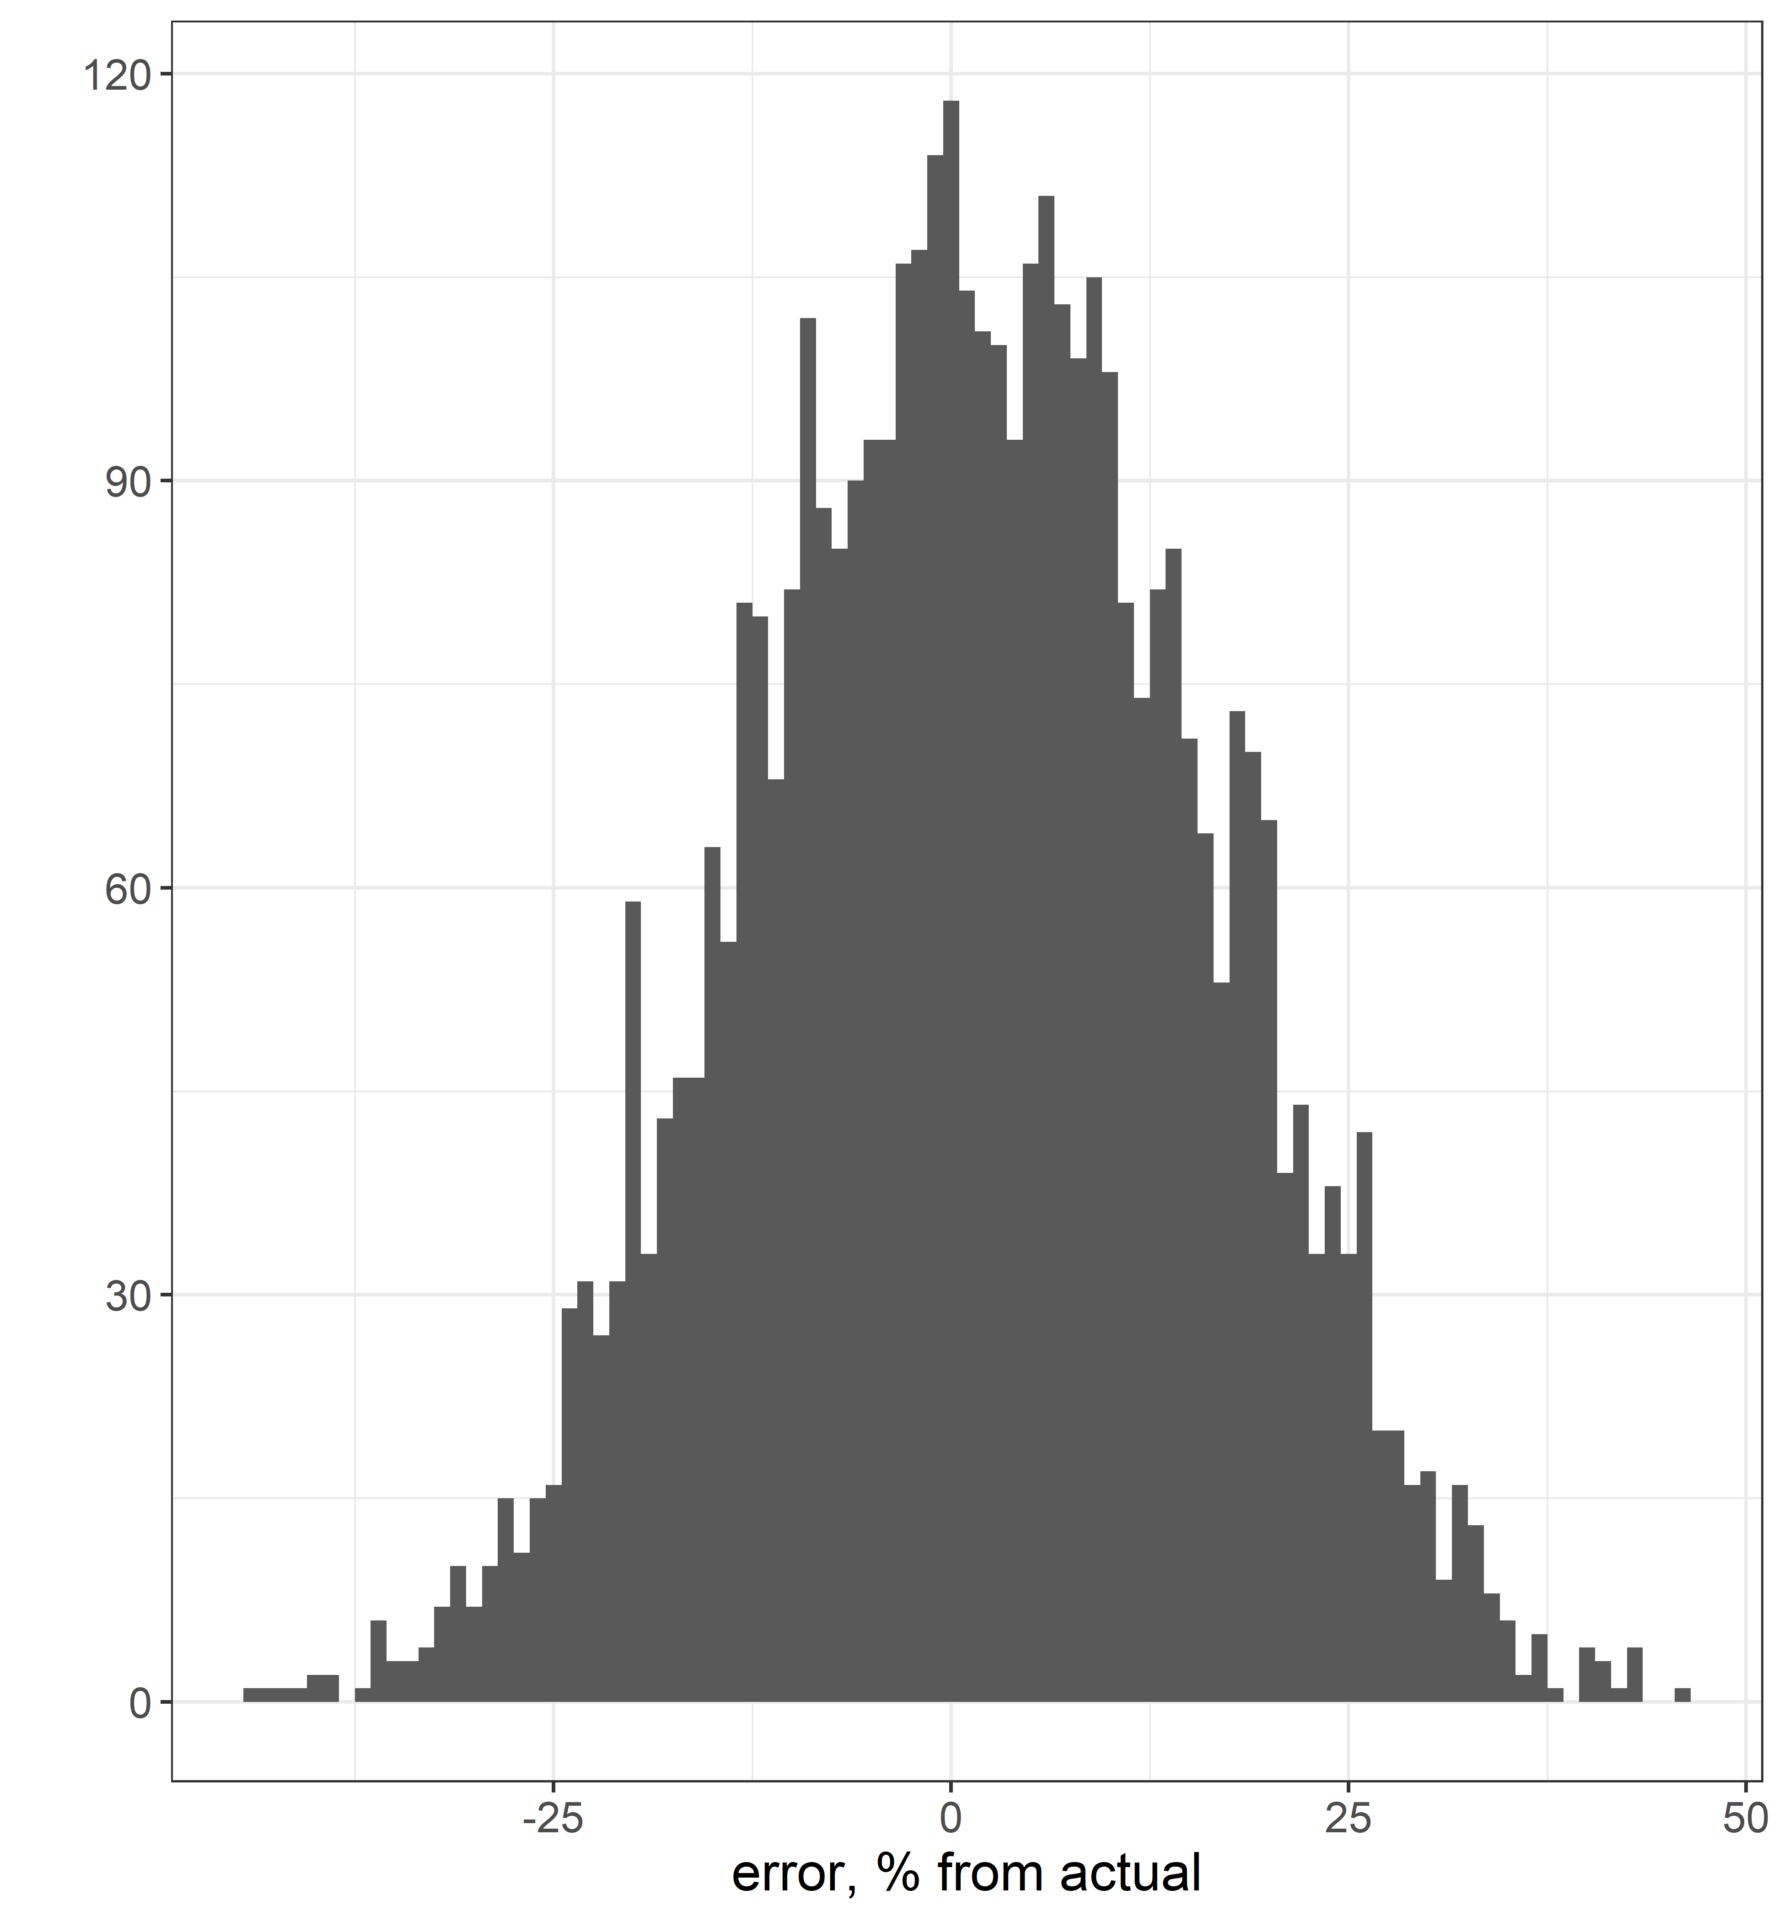
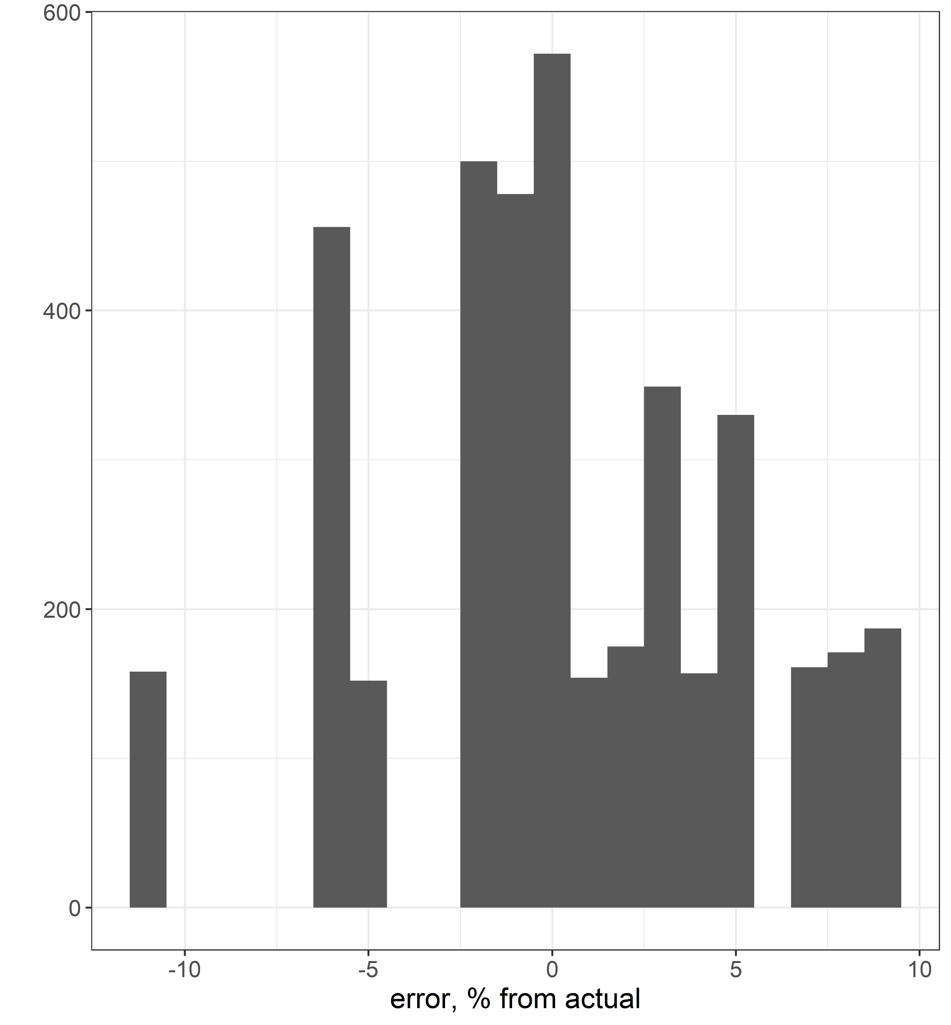
Control section, 4000 simulations (1000 campaign simulations)
Method1
Method2

Slide 5
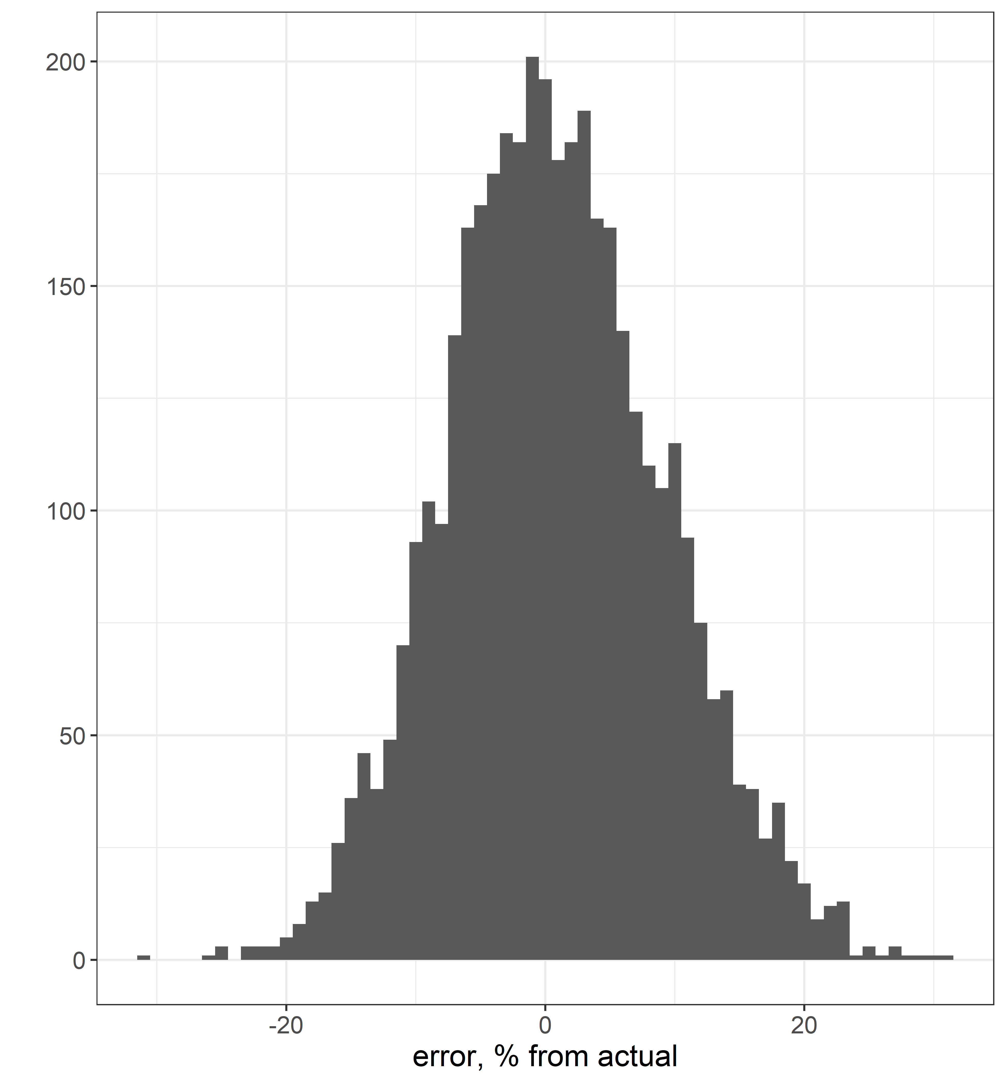
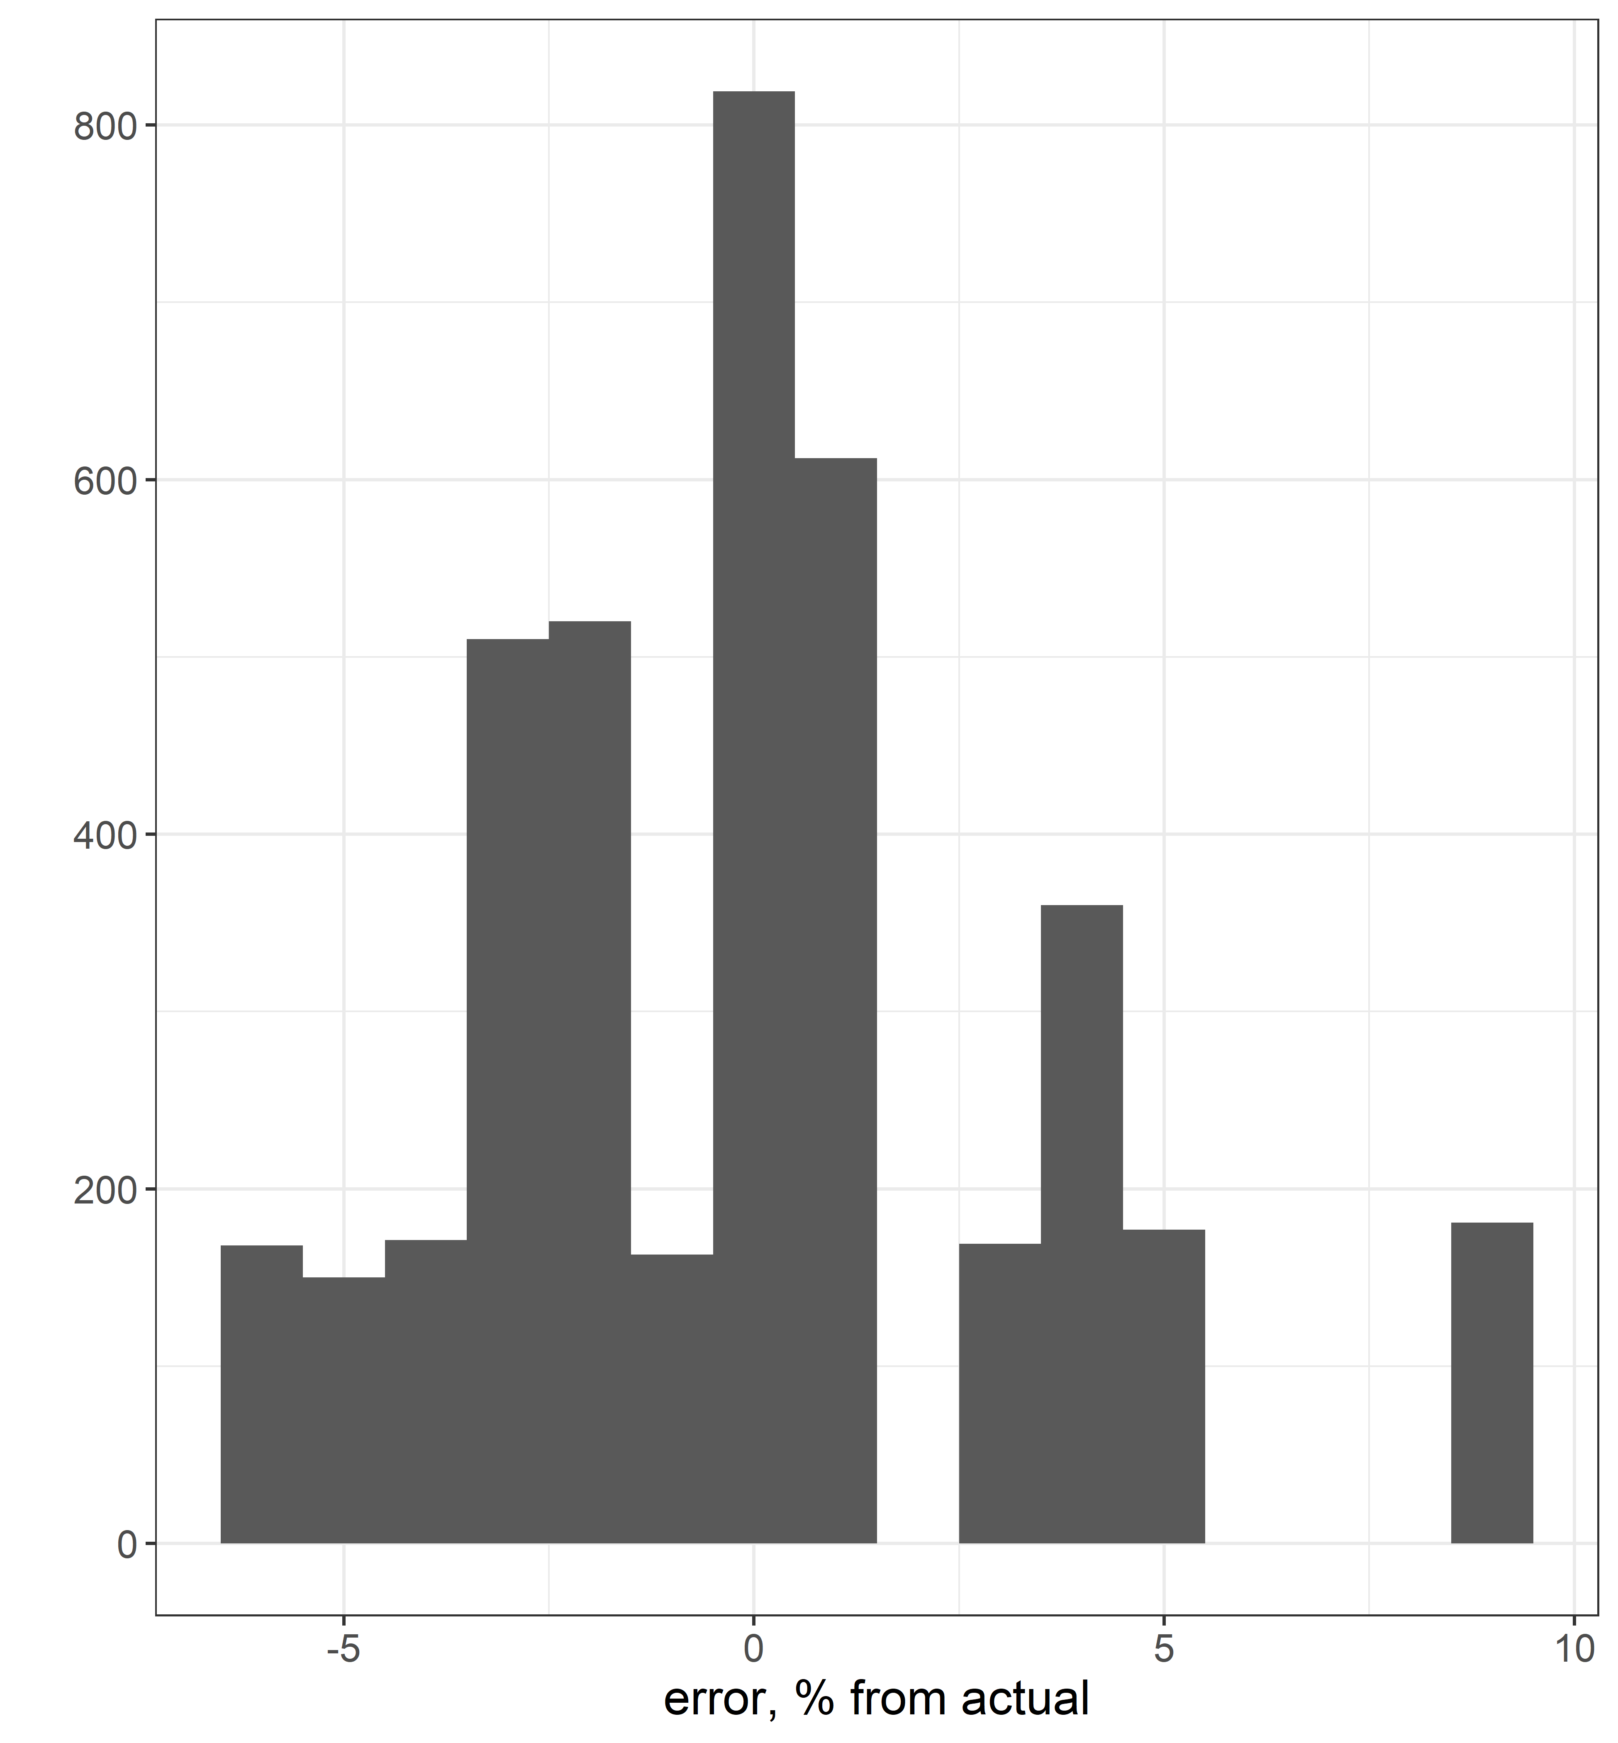
Frequent flushing section, 4000 simulations (1000 campaign simulations)
Method1
Method2

Slide 6
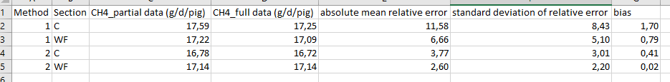
Slight overestimation of methane with the two methods,
but almost nothing for weekly flushing + method2

